Slide 1
Address Translation
Memory Allocation
  Linked lists
  Bit maps
Options for managing memory
  Base and Bound
  Segmentation
  Paging
    Paged page tables
    Inverted page tables
  Segmentation with Paging

Slide 2
Memory Management with Linked Lists
Hole – block of available memory; holes of various size are scattered throughout memory.
When a process arrives, it is allocated memory from a hole large enough to accommodate it.
Operating system maintains two linked lists for
a) allocated partitions b) free partitions (hole)
OS
OS
OS
OS
process 5
process 5
process 5
process 5
process 9
process 9
process 8
process 10
process 2
process 2
process 2
process 2

Slide 3
Dynamic Storage-Allocation Problem
How to satisfy a request of size n from a list of free holes.
First-fit: Allocate the first hole that is big enough.
Best-fit: Allocate the smallest hole that is big enough; must search entire list, unless ordered by size. Produces the smallest leftover hole.
Worst-fit: Allocate the largest hole; must also search entire list. Produces the largest leftover hole.
First-fit and best-fit better than worst-fit in terms of speed and storage utilization.

Slide 4

Memory Allocation with Bit Maps
Part of memory with 5 processes, 3 holes
  tick marks show allocation units
  shaded regions are free
Corresponding bit map
Same information as a list

Slide 5
Fragmentation
External Fragmentation
  Have enough memory, but not contiguous
  Can’t satisfy requests
  Ex: first fit wastes 1/3 of memory on average
Internal Fragmentation – allocated memory may be slightly larger than requested memory; this size difference is memory internal to a partition, but not being used.
Reduce external fragmentation by compaction
  Shuffle memory contents to place all free memory together in one large block.

Slide 6
Segmentation
A segment is a region of logically contiguous memory.
Idea is to generalize base and bounds, by allowing a table of base&bound pairs.
Break virtual memory into segments
Use contiguous physical memory per segment
Divide each virtual address into:
  segment number
  segment offset
  Note: compiler does this, not hardware

Slide 7
Segmentation – Address Translation
Use segment # to index into segment table
  segment table is table of base/limit pairs
Compare to limit, Add base
  exactly the same as base/bound scheme
If greater than limit (or illegal access)
  the segmentation fault

Slide 8

Segmentation Hardware

Slide 9
Example: Four Segments (16 bit addresses)
Seg ID # | Base | Limit
0 (code) | 0x4000 | 0x0800
1 (data) | 0x4800 | 0x1400
2 (shared) | 0xF000 | 0x1000
3 (stack) | 0x0000 | 0x3000
Seg
Offset
15
14
13
0
Virtual Address Format
0x0000
0x0000
0x4000
0x4000
Might
be shared
0x4800
0x5C00
0x8000
Space for
Other Apps
0xC000
0xF000
Shared with
Other Apps
Virtual
Address Space
Physical
Address Space

Slide 10
Example of segment translation
0x240 main: la $a0, varx
0x244 jal strlen
… …
0x360 strlen: li $v0, 0 ;count
0x364 loop: lb $t0, ($a0)
0x368 beq $r0,$t1, done
… …
0x4050 varx dw 0x314159
Seg ID # | Base | Limit
0 (code) | 0x4000 | 0x0800
1 (data) | 0x4800 | 0x1400
2 (shared) | 0xF000 | 0x1000
3 (stack) | 0x0000 | 0x3000
Let’s simulate a bit of this code to see what happens (PC=0x240):
Fetch 0x240. Virtual segment #? 0; Offset? 0x240
Physical address? Base=0x4000, so physical addr=0x4240
Fetch instruction at 0x4240. Get “la $a0, varx”
Move 0x4050 → $a0, Move PC+4→PC
Fetch 0x244. Translated to Physical=0x4244. Get “jal strlen”
Move 0x0248 → $ra (return address!), Move 0x0360 → PC
Fetch 0x360. Translated to Physical=0x4360. Get “li $v0,0”
Move 0x0000 → $v0, Move PC+4→PC
Fetch 0x364. Translated to Physical=0x4364. Get “lb $t0,($a0)”
Since $a0 is 0x4050, try to load byte from 0x4050
Translate 0x4050. Virtual segment #? 1; Offset? 0x50
Physical address? Base=0x4800, Physical addr = 0x4850,
Load Byte from 0x4850→$t0, Move PC+4→PC

Slide 11
Segmentation (cont.)
This should seem a bit strange: the virtual address space has gaps in it! Each segment gets mapped to contiguous locations in physical memory, but may be gaps between segments.
But, a correct program will never address gaps; if it does, trap to kernel and then core dump.
Minor exception: stack, heap can grow. In UNIX, sbrk() increase size of heap segment. For stack, just take fault, system automatically increase size of stack.
Detail: Need protection mode in segmentation table. For example, code segment would be read-only. Data and stack segment would be read-write.

Slide 12
Segmentation Pros & Cons
Efficient for sparse address spaces
  Can keep segment table in registers
Easy to share whole segments (for example, code segment)
Easy for address space to grow
Complicated Memory allocation: still need first fit, best fit, etc., and re-shuffling to coalesce free fragments, if no single free space is big enough for a new segment
How do we make memory allocation simple and easy?

Slide 13
Paging
Allocate physical memory in terms of fixed size chunks of memory, or pages.
Simpler, because allows use of a bitmap. What is a bitmap?
001111100000001100
Each bits represents one page of physical memory – 1 means allocated, 0 means unallocated. Lots simpler than base & bounds or segmentation
OS controls mapping: any page of virtual memory can go anywhere in physical memory

Slide 14
Paging (cont.)
Avoids fitting variable sized memory units
Break physical memory into frames
  Determined by hardware
Break virtual memory into pages
  Pages and frames are the same size
Divide each virtual address into:
  Page number
  Page offset
Note:
  With paging, hardware splits address
  With segmentation, compiler generates segmented code.

Slide 15
Paging – Address Translation
Index into page table with high order bits
  Get physical frame
Append that to offset
Now present new address to memory
Note: kernel keeps track of free frames can be done with a bitmap

Slide 16

Address Translation Architecture

Slide 17
Paging Example
physical memory
virtual memory
I J K L
E F G H
A B C D
A B C D
E F G H
I J K L
4
3
1
Page table
Where is virtual address 6? 9?
Note: Page size is 4 bytes

Slide 18
Paging (Cont.)
Calculating internal fragmentation
  Page size = 2,048 bytes
  Process size = 72,766 bytes
  35 pages + 1,086 bytes
  Internal fragmentation of 2,048 - 1,086 = 962 bytes
  Worst case fragmentation = 1 frame – 1 byte
  On average fragmentation = 1 / 2 frame size
  So small frame sizes desirable?
  But each page table entry takes memory to track
  Page sizes growing over time
    Solaris supports two page sizes – 8 KB and 4 MB
Process view and physical memory now very different
Process can only access its own memory

Slide 19
Shared Pages
Shared code
  One copy of read-only (reentrant) code shared among processes (i.e., text editors, compilers, window systems)
  Similar to multiple threads sharing the same process space
  Also useful for inter-process communication if sharing of read-write pages is allowed
Private code and data
  Each process keeps a separate copy of the code and data
  The pages for the private code and data can appear anywhere in the logical address space

Slide 20

Shared Pages Example

Slide 21
Where is page sharing used ?
The “kernel region” of every process has the same page table entries
  The process cannot access it at user level
  But on U->K switch, kernel code can access it AS WELL AS the region for THIS user
    What does the kernel need to do to access other user processes?
Different processes running same binary!
  Execute-only, but do not need to duplicate code segments
User-level system libraries (execute only)
Shared-memory segments between different processes
  Can actually share objects directly between processes
    Must map page into same place in address space!
  This is a limited form of the sharing that threads have within a single process

Slide 22
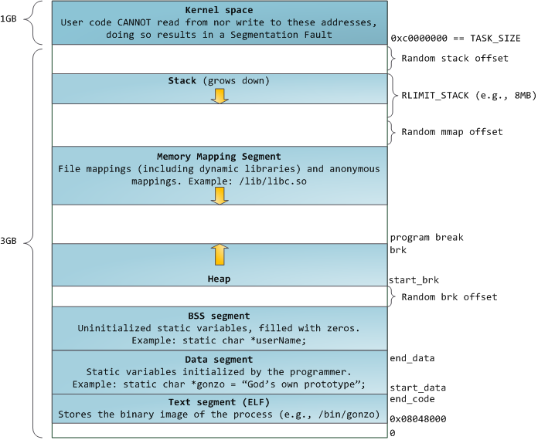
Memory Layout for Linux 32-bit (Pre-Meltdown patch!)
http://static.duartes.org/img/blogPosts/linuxFlexibleAddressSpaceLayout.png

Slide 23
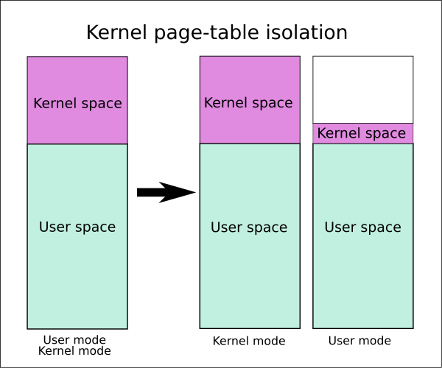
Some simple security measures
Address Space Randomization
  Position-Independent Code ⇒ can place user code anywhere in address space
    Random start address makes much harder for attacker to cause jump to code that it seeks to take over
  Stack & Heap can start anywhere, so randomize placement
Kernel address space isolation
  Don’t map whole kernel space into each process, switch to kernel page table
  Meltdown ⇒ map none of kernel into user mode!

Slide 24
Paging Issues
Fragmentation
Page Size
Protection and Sharing
Page Table Size
What if page table too big for main memory?

Slide 25
Fragmentation and Page Size
Fragmentation
  No external fragmentation
    Page can go anywhere in main memory
  Internal fragmentation
    Average: ½ page per address space
Page Size
  Small size?
    Reduces (on average) internal fragmentation
  Large size?
    Better for page table size
    Better for disk I/O
    Better for number of page faults
  Typical page sizes: 4K, 8K, 16K

Slide 26
Protection and Sharing
Page protection – use a bit
  code: read only
  data: read/write
Sharing
  Just “map pages in” to your address space
    Ex: if “vi” is at frames 0 through 10, all processes can adjust their page tables to “point to” those frames.

Slide 27
Summary: Paging
Page Table
Virtual memory view
Physical memory view
1111 1111
11111 11101
11110 11100
11101 null
11100 null
11011 null
11010 null
11001 null
11000 null
10111 null
10110 null
10101 null
10100 null
10011 null
10010 10000
10001 01111
10000 01110
01111 null
01110 null
01101 null
01100 null
01011 01101
01010 01100
01001 01011
01000 01010
00111 null
00110 null
00101 null
00100 null
00011 00101
00010 00100
00001 00011
00000 00010
1110 1111
1111 0000
stack
stack
1110 0000
1100 0000
heap
1000 0000
heap
0111 000
data
data
0101 000
0100 0000
code
code
0001 0000
0000 0000
0000 0000
page #
offset

Slide 28
Summary: Paging
Page Table
Virtual memory view
Physical memory view
1111 1111
11111 11101
11110 11100
11101 null
11100 null
11011 null
11010 null
11001 null
11000 null
10111 null
10110 null
10101 null
10100 null
10011 null
10010 10000
10001 01111
10000 01110
01111 null
01110 null
01101 null
01100 null
01011 01101
01010 01100
01001 01011
01000 01010
00111 null
00110 null
00101 null
00100 null
00011 00101
00010 00100
00001 00011
00000 00010
stack
1110 0000
stack
1110 0000
1100 0000
What happens if stack grows to 1110 0000?
heap
1000 0000
heap
0111 000
data
data
0101 000
0100 0000
code
code
0001 0000
0000 0000
0000 0000
page #
offset

Slide 29
Summary: Paging
Page Table
Virtual memory view
Physical memory view
1111 1111
11111 11101
11110 11100
11101 10111
11100 10110
11011 null
11010 null
11001 null
11000 null
10111 null
10110 null
10101 null
10100 null
10011 null
10010 10000
10001 01111
10000 01110
01111 null
01110 null
01101 null
01100 null
01011 01101
01010 01100
01001 01011
01000 01010
00111 null
00110 null
00101 null
00100 null
00011 00101
00010 00100
00001 00011
00000 00010
stack
1110 0000
stack
1110 0000
1100 0000
stack
Allocate new pages where room!
heap
1000 0000
heap
0111 000
data
Challenge: Table size equal to # of pages in virtual memory!
data
0101 000
0100 0000
code
code
0001 0000
0000 0000
0000 0000
page #
offset

Slide 30
Page Table Discussion
What needs to be switched on a context switch?
  Page table pointer and limit
Analysis
  Pros
    Simple memory allocation
    Easy to share
  Con: What if address space is sparse?
    E.g., on UNIX, code starts at 0, stack starts at (2³¹-1)
    With 1K pages, need 2 million page table entries!
  Con: What if table really big?
    Not all pages used all the time ⇒ would be nice to have working set of page table in memory
How about multi-level paging or combining paging and segmentation?
Notes:
What if page size is very small? VAX had a 512-byte page size = lots of space for page table entries
What if page size is really big? Wastes space inside of page (internal fragmentation)

Slide 31
Fix for sparse address space: The two-level page table
Physical
Address:
Physical
Page #
Offset
10 bits
10 bits
12 bits
Virtual
Address:
Virtual
P1 index
Virtual
P2 index
Offset
4KB
PageTablePtr
4 bytes
Tree of Page Tables
Tables fixed size (1024 entries)
  On context-switch: save single PageTablePtr register
Valid bits on Page Table Entries
  Don’t need every 2nd-level table
  Even when exist, 2nd-level tables can reside on disk if not in use
4 bytes

Slide 32
Summary: Two-Level Paging
Virtual memory view
Page Tables
(level 2)
Physical memory view
1111 1111
stack
11 11101
10 11100
01 10111
00 10110
stack
1110 0000
1111 0000
1100 0000
Page Table
(level 1)
stack
111
110 null
101 null
100
011 null
010
001 null
000
11 null
10 10000
01 01111
00 01110
heap
1000 0000
heap
0111 000
11 01101
10 01100
01 01011
00 01010
data
data
0101 000
0100 0000
11 00101
10 00100
01 00011
00 00010
code
page2 #
code
0001 0000
0000 0000
0000 0000
page1 #
offset

Slide 33
Summary: Two-Level Paging
Virtual memory view
Page Tables
(level 2)
Physical memory view
stack
11 11101
10 11100
01 10111
00 10110
stack
1110 0000
Page Table
(level 1)
stack
111
110 null
101 null
100
011 null
010
001 null
000
11 null
10 10000
01 01111
00 01110
1001 0000
(0x90)
heap
heap
1000 0000
(0x80)
In best case, total size of page tables ≈ number of pages used by program virtual memory. Requires two additional memory access!
11 01101
10 01100
01 01011
00 01010
data
data
11 00101
10 00100
01 00011
00 00010
code
code
0001 0000
0000 0000

Slide 34
Multi-level Translation:
Paging the Segments
Divide address into three parts
  Segment number
  Page number
  Offset
Segment table contains addr. of page table
Use that and page # to get frame #
Combine frame number and offset

Slide 35
What does this buy you?
Simple management of physical memory
  Paging (just a bitmap)
Maintain logical structure
  Segmentation
However,
  Possibly 3 memory accesses to get to memory!

Slide 36
Paging the Segments
What about a tree of tables?
  Lowest level page table ⇒ memory still allocated with bitmap
  Higher levels often segmented
Could have any number of levels. Example (top segment):
What must be saved/restored on context switch?
  Contents of top-level segment registers (for this example)
  Pointer to top-level table (page table)
Virtual
Address:
Virtual
Seg #
Virtual
Page #
Offset
page #0
V,R
Base0
Limit0
V
page #1
V,R
Physical
Page #
Offset
page #2
V,R,W
Base1
Limit1
V
page #2
V,R,W
Physical Address
Base2
Limit2
V
page #3
V,R,W
Base2
Limit2
V
Base3
Limit3
N
page #4
N
Base4
Limit4
V
page #5
V,R,W
Check Permissions
Base5
Limit5
N
Base6
Limit6
N
Base7
Limit7
V
>
Access
Error
Access
Error

Slide 37
What about Sharing (Complete Segment)?
Process A
Virtual
Seg #
Virtual
Page #
Offset
page #0
V,R
page #1
V,R
page #2
V,R,W
Base0
Limit0
V
page #3
V,R,W
Base1
Limit1
V
page #4
N
Base2
Limit2
V
Base2
Limit2
V
page #5
V,R,W
Base3
Limit3
N
Base4
Limit4
V
Shared Segment
Base5
Limit5
N
Base6
Limit6
N
Base0
Limit0
V
Base7
Limit7
V
Base1
Limit1
V
Base2
Base2
Limit2
Limit2
V
V
Base3
Limit3
N
Base4
Limit4
V
Base5
Limit5
N
Base6
Limit6
N
Base7
Limit7
V
Process B
Virtual
Seg #
Virtual
Page #
Offset

Slide 38
x86-64 Page Table
In x86-64 virtual address has 64 bits, but only the first 48 bits are meaningful. We have 9 bits to index into each page table level, and 12 bits for the offset. This means 16 bits are left over and unused.
Page sizes: 4KB, 2MB, 1GB
63-48 | 47-39 | 38-29 | 29-21 | 20-12 | 11-0
 | L4 | L3 | L2 | L1 | OFFSET

Slide 39
Multi-level Translation Analysis
Pros:
  Only need to allocate as many page table entries as we need for application
    In other words, sparse address spaces are easy
  Easy memory allocation
  Easy Sharing
    Share at segment or page level (need additional reference counting)
Cons:
  One pointer per page (typically 4K – 16K pages today)
  Page tables need to be contiguous
    However, previous example keeps tables to exactly one page in size
  Two (or more, if >2 levels) lookups per reference
    Seems very expensive!

Slide 40
Inverted Page Table (“Core Map”)
One entry for each real page of memory.
Entry consists of the virtual address of the page stored in that real memory location, with information about the process that owns that page.
Decreases memory needed to store each page table, but increases time needed to search the table when a page reference occurs.
Use hash table to limit the search to one — or at most a few — page-table entries.
Good for page replacement

Slide 41

Inverted Page Table Architecture

Slide 42
Address Translation Comparison
 | Advantages | Disadvantages
Simple Segmentation | Fast context switching (segment map maintained by CPU) | External fragmentation
Paging (Single-Level) | No external fragmentation Fast and easy allocation | Large table size Internal fragmentation
Paged Segmentation | Table size ~ # of pages in virtual memory Fast and easy allocation | Multiple memory references per page access
Multi-Level Paging
Inverted Page Table | Table size ~ # of pages in physical memory | Hash function more complex No cache locality of page table

Slide 43
Summary
Segment Mapping
  Segment registers within processor
  Segment ID associated with each access
    Often comes from portion of virtual address
    Can come from bits in instruction instead (x86)
  Each segment contains base and limit information
    Offset (rest of address) adjusted by adding base
Page Tables
  Memory divided into fixed-sized chunks of memory
  Virtual page number from virtual address mapped through page table to physical page number
  Offset of virtual address same as physical address
  Large page tables can be placed into virtual memory
Multi-Level Tables
  Virtual address mapped to series of tables
  Permit sparse population of address space

